Slide 1



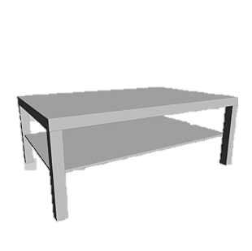
Studying Human Preferences in Human-robot Task Allocation
What does it mean?
I don’t prefer this task
Zahra Safari Dehnavi
Dr. Tamas Ruppert

Slide 2
Introduction
Task allocation is a fundamental challenge in human-robot collaboration (HRC).
Current methods often prioritize efficiency over human wellbeing.
Human factors approaches claim to design work systems fitting to human characteristics.
Human wellbeing can be inferred through self-reported preferences.
Incorporating human preferences into task allocation remains limited.
The role of individualized preferences in adaptive task distribution is largely unexplored.
This highlights a research gap in studying the underlying reasons for human preferences in task allocation.

Slide 3
State of the art:
Several algorithms integrate human factors, such as cognitive/physical ergonomics and personal preferences, into task allocation, enhancing adaptability and well-being [1-3].
Christina’s work [4]:
Allowing participants to control task allocation increases their satisfaction and perceived competence.
Participants tend to prefer cognitive tasks for themselves and assign manual tasks to the robot.
Many studies suggest that preferences in decision-making arise from different cognitive and neural processes [5].
[1] M.C.Gombolay,R.A.Gutierrez,S.G.Clarke,G.F.Sturla,andJ.A.Shah, “Decision-making authority, team efficiency and human worker satisfac tion in mixed human–robot teams,” Auton Robot, vol. 39, pp. 293–312, 2015.
[2] M. Gombolay, A. Bair, C. Huang, and J. Shah, “Computational design of mixed-initiative human–robot teaming that considers human factors: situational awareness, workload, and workflow preferences,” Int. J. Robot. Res., vol. 36, no. 5–7, pp. 597–617, 20
[3] D. Dhungana et al., “Enabling resilient production through adaptive human-machine task sharing,” in Towards Sustainable Customization: Bridging Smart Products Manuf. Syst., A.-L. Andersen, Eds. Cham, Switzerland:Springer, 2022, pp. 198–206.
[4] Schmidbauer, C., Zafari, S., Hader, B., & Schlund, S. (2023). An empirical study on workers' preferences in human–robot task assignment in industrial assembly systems. IEEE Transactions on Human-Machine Systems, 53(2), 293-302.
[5] Evans, J. S. B. (2008). Dual-processing accounts of reasoning, judgment, and social cognition. Annu. Rev. Psychol., 59(1), 255-278.

Slide 4
Research Questions
To what extent do self-reported human preferences correlate with individual task-related capabilities in human-robot collaboration?
To what extent do human preferences correlate with their perception of robot capabilities in human-robot collaboration?
What factors (e.g., task difficulty, familiarity, trust in the robot) contribute to the formation of individual task preferences in HRC settings?

Slide 5
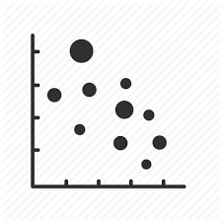
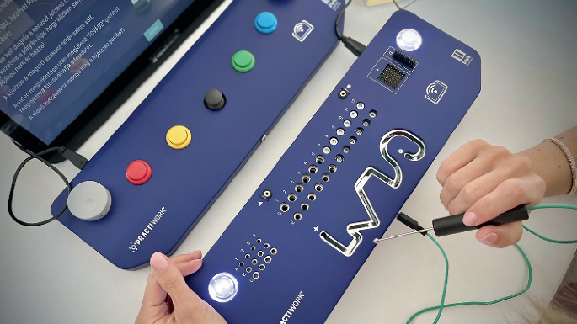
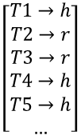
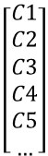
Study Setting
Design a human-robot collaboration scenario for a personalized assembly task.
Assess individual human capabilities prior to the collaboration.
Allow participants to self-allocate tasks between themselves and the robot.
Analyze the correlation/pattern between participants’ capabilities and their task allocation decisions.
Human will allocate the tasks
Post-questionnaire: Capability vs TA
Pattern?
Pre-questionnaire: Human capability and robot perception
Capability
Preference
Human Capability/skill:
Pick & Place
Screw
Palletizing
Quality check
Wire handling
….
Result?
Task allocation
$$\left[\begin{aligned}C1 \\ C2 \\ C3 \\ C4 \\ C5 \\ …\end{aligned}\right]$$
$$\left[\begin{aligned}T1→h \\ T2→r \\ T3→r \\ T4→h \\ T5→h \\ …\end{aligned}\right]$$

Slide 6
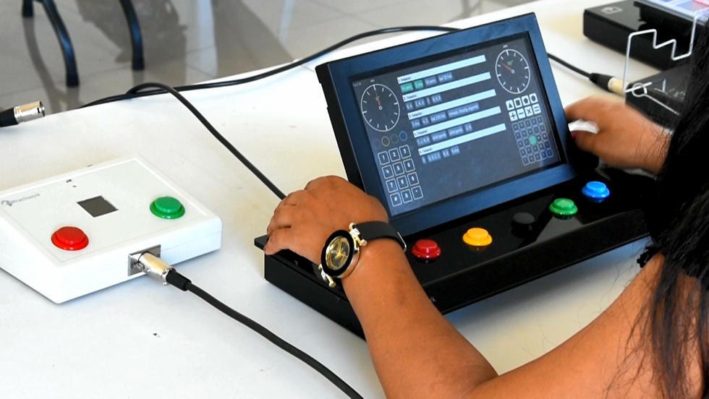

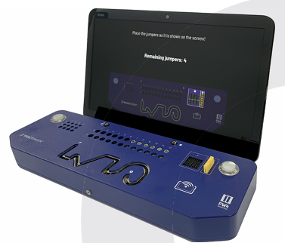
Practiwork
Developing employee evaluation systems, including: Developing a performance assessment system; Providing consultancy on performance assessment.
Assessment:
Reasoning
Psychometric: e.g. Hand dexterity, hand stability
~ 15 min experiment

Slide 7
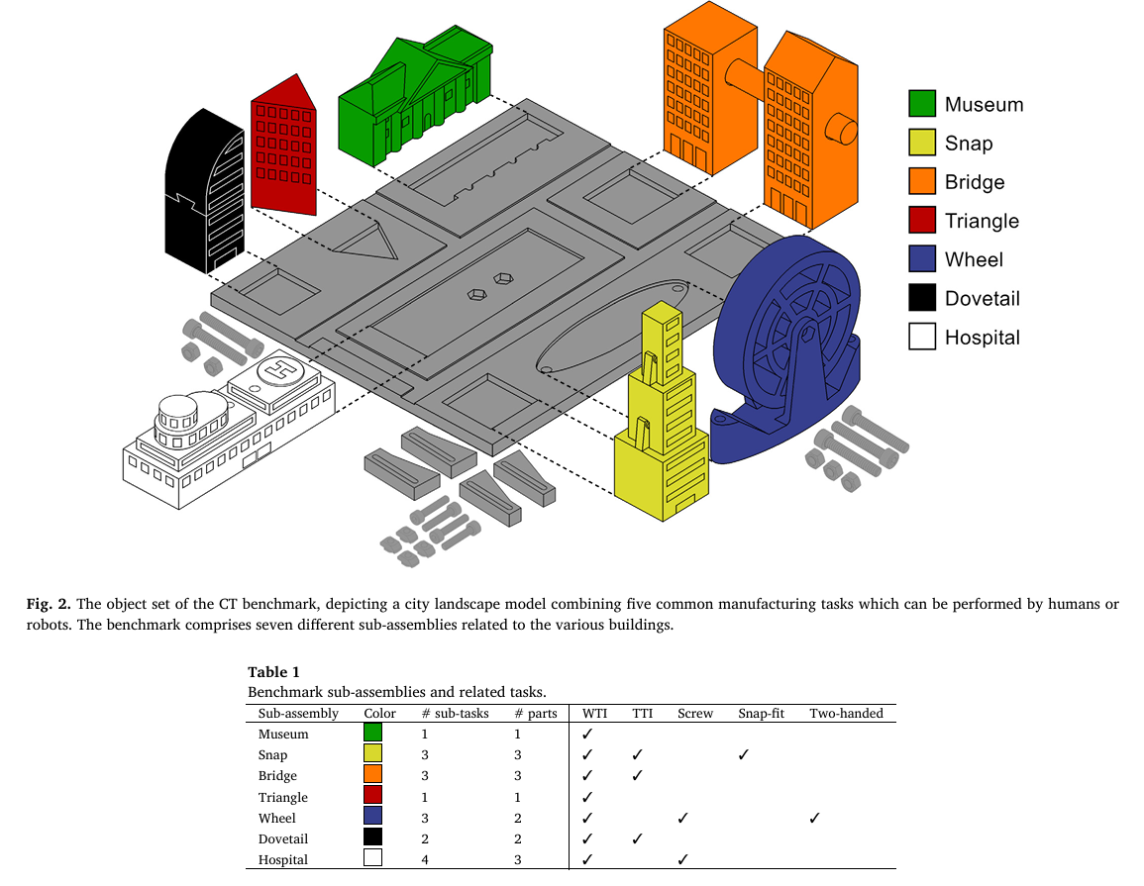
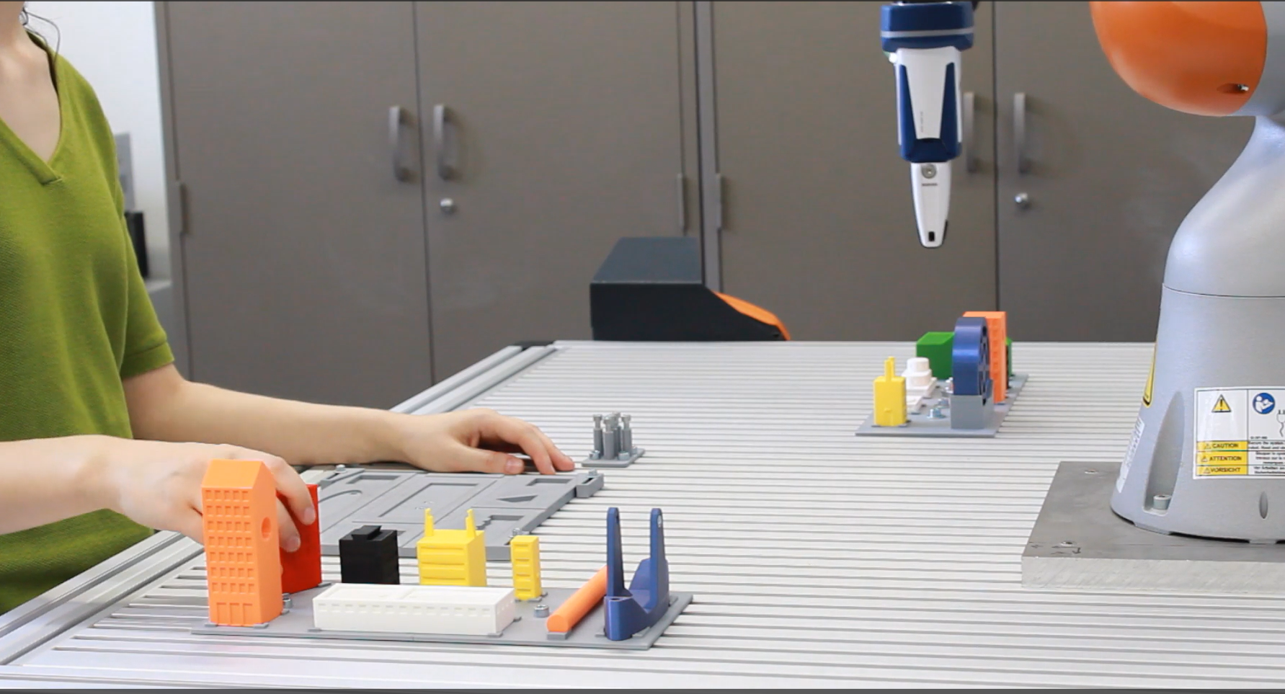
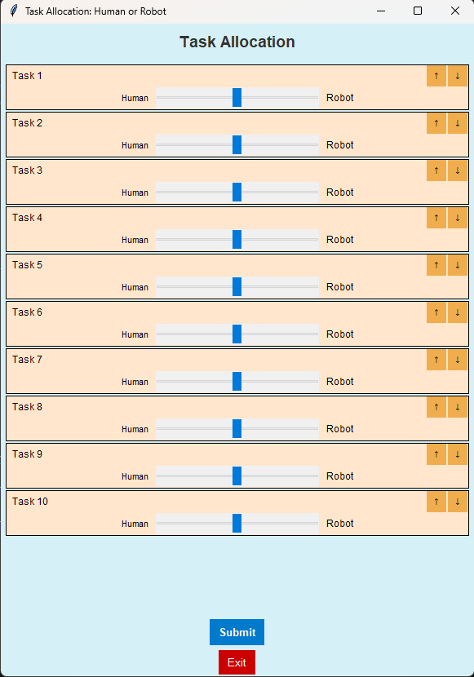
Study Design
A human-robot collaboration scenario for a personalized assembly task ~60 min
Skill assessment ~15min : Practiwork
Familiarization ~10 min: Observing the robot perform the task three times as a learning phase
→ general attitude toward robots
Human Trials ~10 min: only human perform the assembly 3X → followed by Nasa-TLX
TA trials ~10min: human trying the TA 3X
Test under time pressure→ Followed by Nasa-TLX, general attitude toward robots, SUS
wide tolerance insertions (WTI),
the tight tolerance insertion (TTI),
screw fastening,
snap fitting and
two-handed actions.
Benchmarking human-robot collaborative assembly tasks

Slide 8
Expected Outcome
Identification of patterns linking human capabilities to their task preferences.
Discovery of correlations between perceived robot capabilities and human task preferences.
Recognition of additional influencing factors (e.g., task difficulty, familiarity, trust in the robot) that shape individual preferences.
Insights into variability of preferences across individuals with similar capabilities.

Slide 9
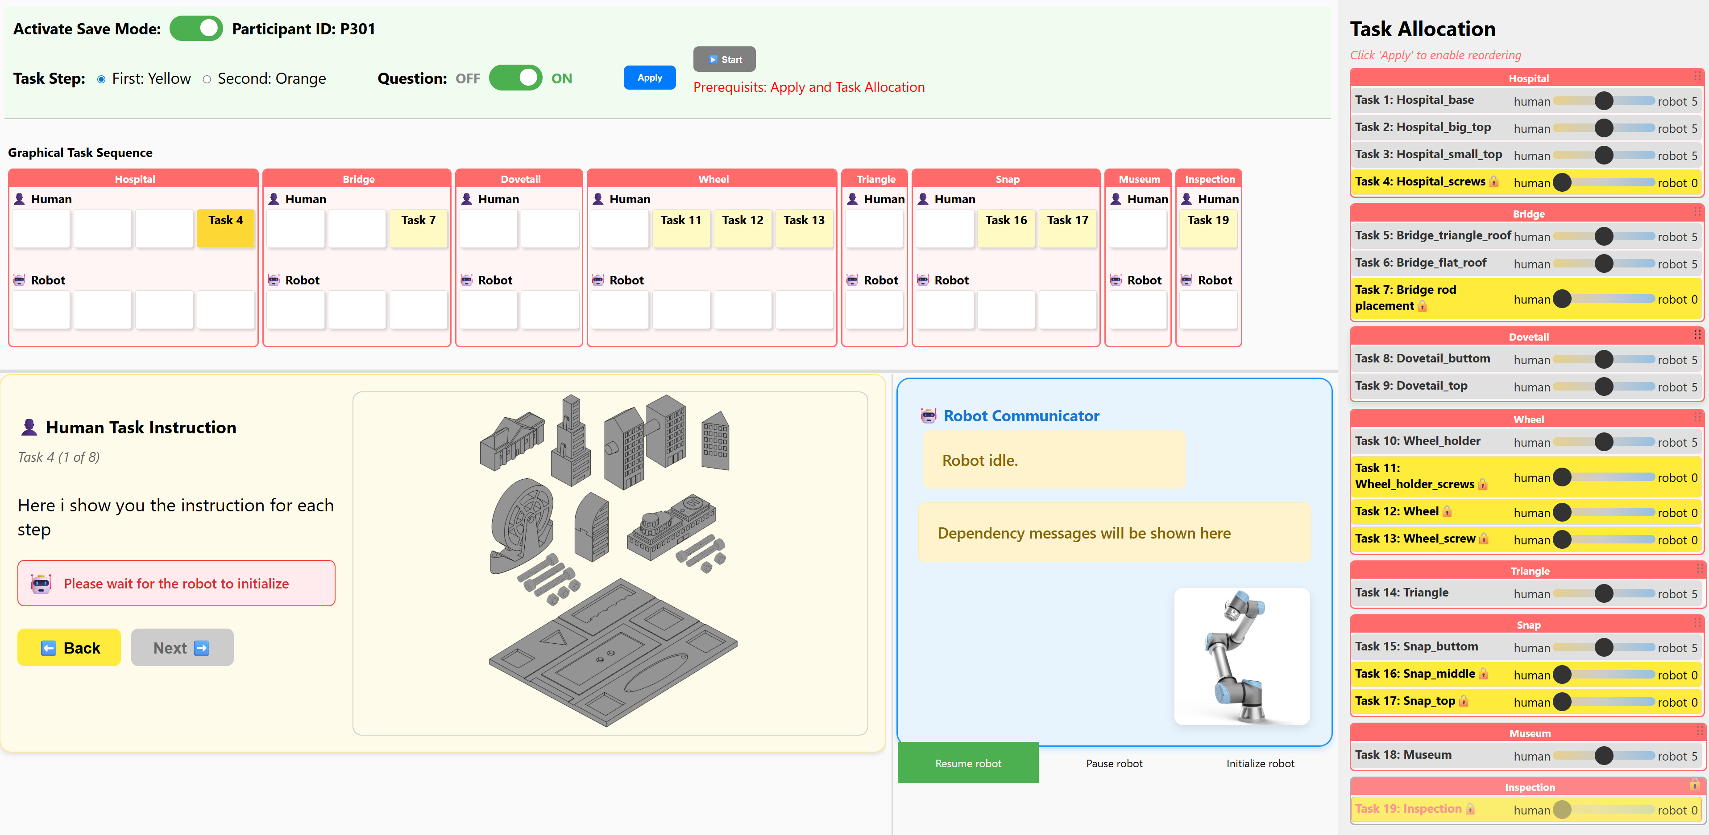
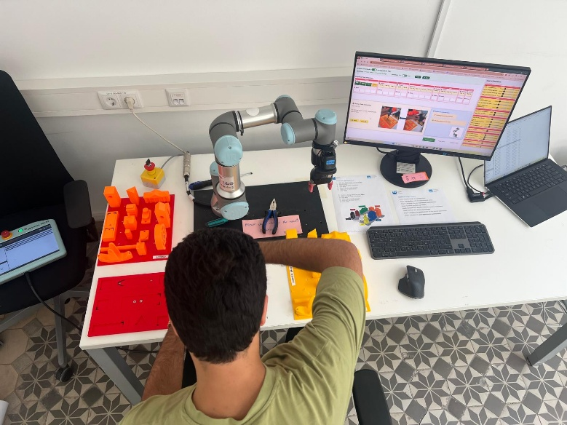
Experiment Layout
A Q-learning algorithm has been developed to optimize task planning in multi-human, multi-robot collaboration scenarios.
Running an experiment in HRC to find out human preferences in Task allocation

Slide 10
Descriptive results
Self Assesment:

Slide 11
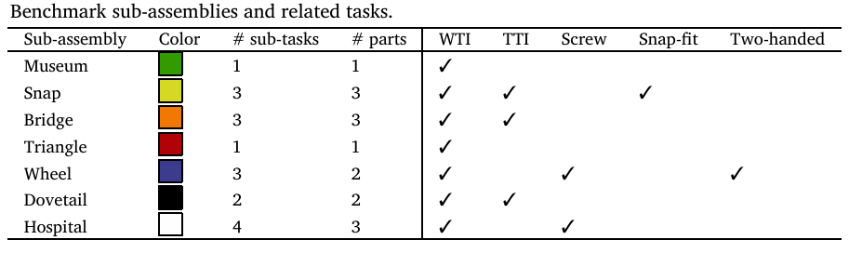
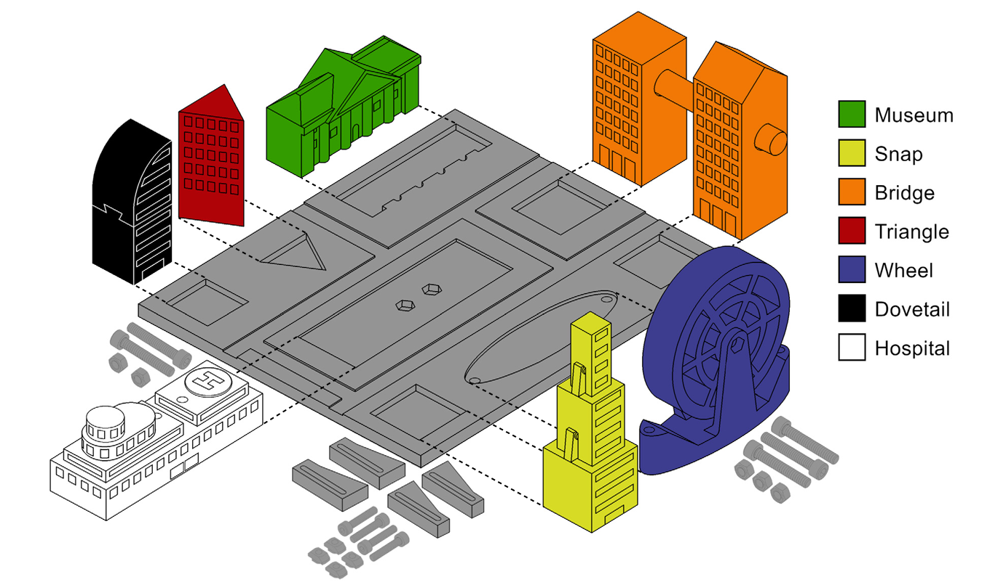
Experiment:
Task | Parts | Type | Agent | Dependency | Robot_time
1 | Museum | W_PP |  | 0
2 | Triangle | W_PP |  | 0
3 | Snap_base | W_PP |  | 0
4 | Snap_middle | Snap |  | 1
5 | Snap_top | Snap |  | 2
6 | Wheel_base | W_PP |  | 0
7 | Wheel_b_screw | screw |  | 1
8 | Wheel | T_PP |  | 1
9 | Wheel_screw | Screw | Only H? | 2
10 | Bridge_home | W_PP |  | 0
11 | Bridge_home2 | W_PP |  | 0
12 | Bridge_rod | T_PP |  | 2
13 | Dovetail_base | W_PP |  | 0
14 | Dovetail_top | T_PP |  | 1
15 | Hospital_base | W_PP |  | 0
16 | Hospital_H | T_PP |  | 1
17 | Hospital_top | T_PP |  | 1
18 | Hospital_screw | Screw | Only H? | 3
Based on the paper, total time of assembly for
Only human: 120 seconds
Collaboration: 205 seconds
Only robot: 419 seconds

Slide 12

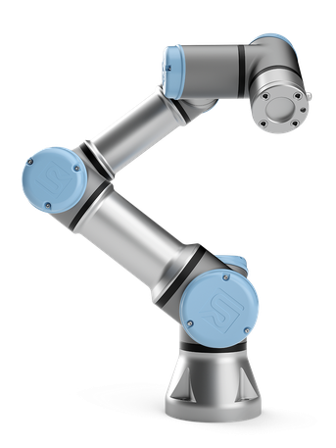
Zahra Todos
Buy screws- OBI
Connect interface with the robot_ bring the adapter from pilotfactory
Prepare the steps and the environment
Finalize the code with exact movements

